Slide 1
Coordinator Training (K-8)

Slide 2
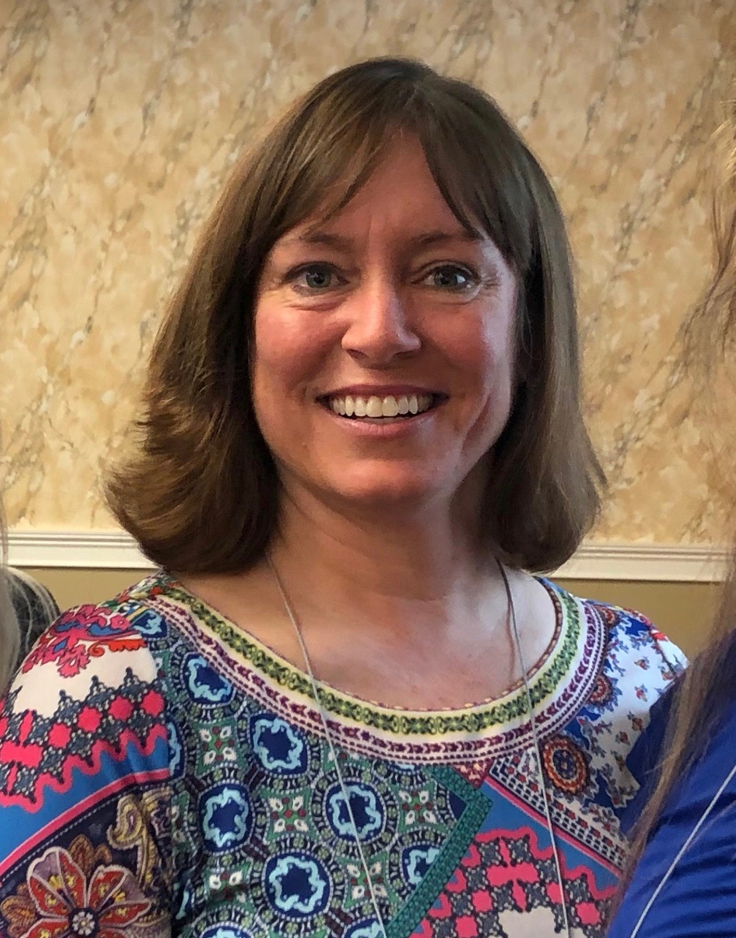
SFFC Foundation
The SFFC Foundation is a nonprofit organization based in Nashville, TN. Our current initiatives include the PFE Scholarship and Nourish Grants for individuals/families.
Administration Team
Ashley Beisiegel Jackie Downs
K-8 Program Officer 9-12 Program Officer
Office Number: (615) 675-0450

Slide 3
Origin Video

Slide 4
Your Commitments
Manage student selection process.
Work with your team to provide an orientation for students and parents before students start their visits for the year.
Partner with Mentor Liaison to oversee that students are matched with mentors to ensure compatibility, a nurturing environment, and compliance with scholarship guidelines.
Provide support to students, parents, and mentors as needed.
Review visit reflections
Verify that all reflections are approved by the 7th of each month.
Complete the end-of-year survey

Slide 5
Student Selection
Participant slots are based on school enrollment
Schools with enrollment of 30 or fewer are allowed up to 50% participation
Schools with enrollment of 31 or more are allowed up to 20% participation
This scholarship is for:
Students and parents who are passionate about serving others.
Students who would benefit from a positive intergenerational connection.
PFE is not a needs-based scholarship.
Primary selection criteria should be a passion to serve.

Slide 6
Student/Parent Orientation
You are required to hold a yearly orientation that each participant (and PFE parent) is required to attend.
Orientation:
Does not count as scholarship time and will not be paid.
Must take place before students commence their visits for the year.
PowerPoint and student packet are provided (on Resources page of website)
*New AND returning PFE students are required to attend orientation every year
Tip: Have students create their account on the reporting website during orientation.

Slide 8
PFE Visits
PFE visits for grades K-8 are:
One hour long
Once per week (Aug-May)
With the same mentor
Interactive and in a home environment
Make-up Visits
Maximum of one per month
Must be on a separate day than regular visit
Students receive $30 per visit in tuition assistance
70% from SFFC and 30% fundraised by school
*Virtual visits do not count towards scholarship time

Slide 9
Student/Mentor Matches
PFE was designed to ease senior isolation.
An ideal mentor is a cognitively healthy, older adult or someone with a disability who could use company and/or light assistance around the home.
Mentor Selection
Families can choose their own mentors (1 for each child) or your team may provide a list of suggested mentors from your community.
Non-negotiable criteria:
No nursing home residents.
Cognitive health
Commitment: A mentor must be able to commit to consistent, weekly visits.
Students may not be matched with a relative by any degree.
Reflect on past mentors in your life as you help your students choose theirs.

Slide 10
Mentor Communication
You or your Mentor Liaison are required to communicate with each mentor at the beginning of the year before students start visiting.
Each conversation should be comprised of the following elements:
Program goals
Program expectations (consistency of visits, appropriate activities, the mentor’s role, etc.)
What the visits should/might look like
Providing the mentor packet
Contact information for the Mentor Liaison

Slide 11
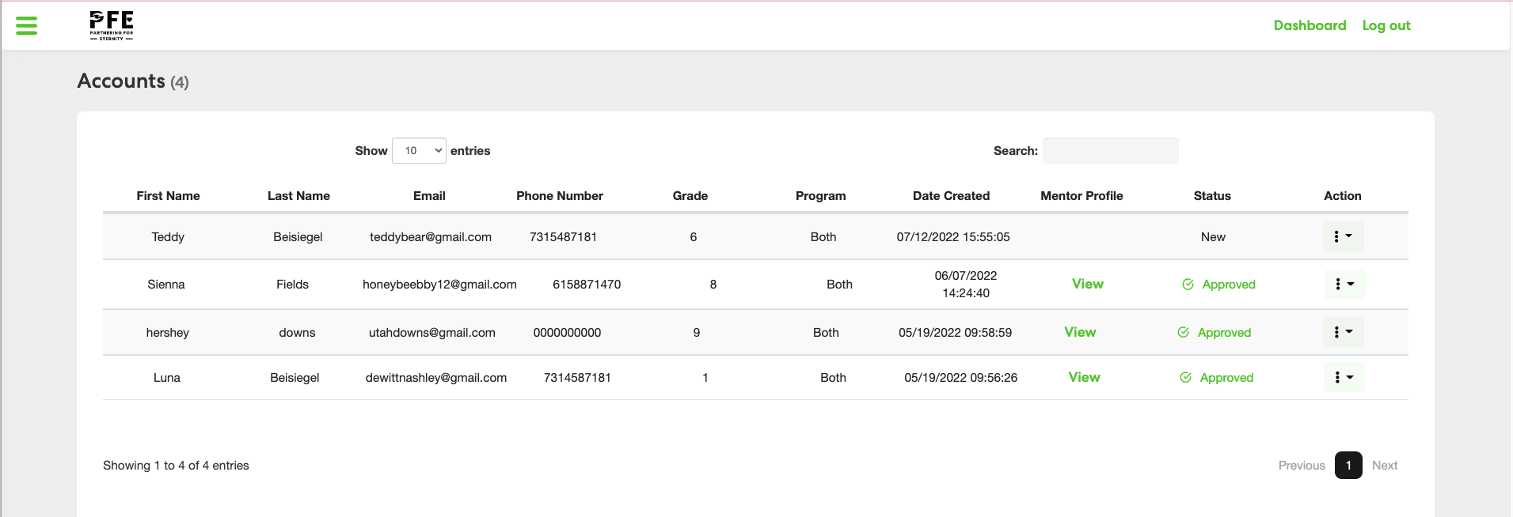

Slide 13
Monthly Scholarship
Monthly Deadline: 7th
You will have one week at the end of the month to review and approve of final reflections.
Reports are processed on the 8th day of the following month.
Once your monthly report is processed, additions or changes will not be accepted.

Slide 14
Safety
In order to keep each student/mentor safe while visiting:
A parent or legal guardian (K-8 students) is required to accompany and supervise on every visit.
Visits that occur without parental supervision will not be funded.
Make sure you are complying with any of your conference’s policies for student safety, including background checks, if applicable.

Slide 15
Impact Video

